Slide 1

Informative Seafloor Exploration for Benthic Habitat Mapping
Kelvin Hsu

Slide 2

How much of the ocean seafloor have we mapped?
Notes:
I want to start of by asking: How much of the ocean do you think we have mapped?

Slide 3
How much of the ocean seafloor have we mapped?
“95% of the ocean remains unexplored”
Notes:
There is this general consensus that we have only explored 5% of the seafloor, leaving 95% of the ocean a mystery.

Slide 4
How much of the ocean seafloor have we mapped?
“95% of the ocean remains unexplored”
100% mapped at resolution of 5 km
Notes:
But actually, we do have a map of the entire ocean floor through satellite observations, just at a very crude resolution of 5 km.

Slide 5
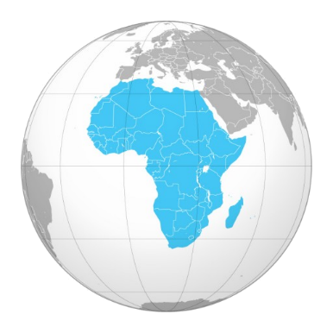
How much of the ocean seafloor have we mapped?
“95% of the ocean remains unexplored”
100% mapped at resolution of 5 km
10% to 15% mapped at resolution of 100 m
Notes:
For better resolutions, we can use SONAR techniques from ships at sea level. This gives us about 10% to 15% of the ocean covered, which is about the size of Africa. That’s not that bad either. However, that’s just the structural features of the seafloor, which we call Bathymetric features.

Slide 6
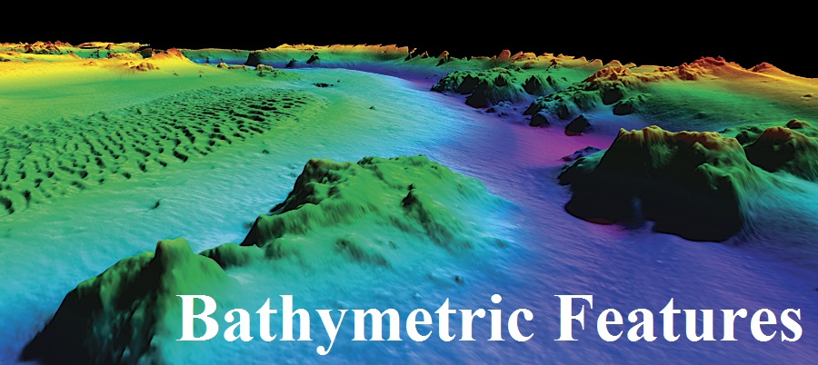
How much of the ocean seafloor have we mapped?
“95% of the ocean remains unexplored”
100% mapped at resolution of 5 km
10% to 15% mapped at resolution of 100 m
Notes:
And that’s not really THAT cool. What we really want to know about are the exotic creatures and funny looking fishies and the environmental habitats they live in. We call these Benthic Habitats.

Slide 7
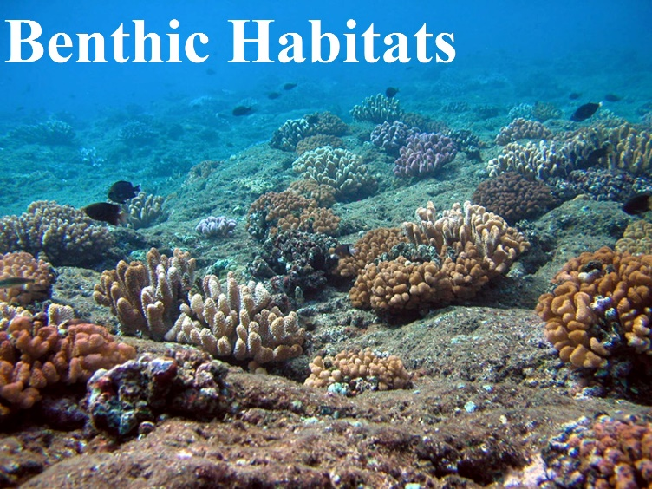
How much of the ocean seafloor have we mapped?
“95% of the ocean remains unexplored”
100% mapped at resolution of 5 km
10% to 15% mapped at resolution of 100 m
Notes:
So how much of those habitat areas have we actually visited?

Slide 8
How much of the ocean seafloor have we mapped?
“95% of the ocean remains unexplored”
100% mapped at resolution of 5 km
10% to 15% mapped at resolution of 100 m
Less than 0.05% actually visited!
Notes:
Surprisingly, only 0.05%! For a planet which is 70% covered with ocean, we really do not know much about the Earth’s most abundant type of habitats. This is why we deploy Autonomous Underwater Vehicles, or AUVs, to take pictures of the Benthic Seafloor so that we can make a good map of it. But there is so much of the ocean to explore. Unlike using SONAR from floating ships, AUVs travel much slower underwater and are also more expensive due to the mission costs. They are also very limited in battery power supply. Basically, AUVs cannot map benthic habitats at the rate ships have mapped seafloor bathymetry using SONAR. This raises the question, how should we best explore the seafloor to map the benthic habitats as best as we can under cost and time constraints?

Slide 9

Informative Seafloor Exploration
for
Benthic Habitat Mapping
Knowing the Bathymetry… which way should I go?
Notes:
My name is Kelvin, and today I would like to chat to you about informative seafloor exploration for benthic habitat mapping. The idea is for the AUV to focus on exploring the most ‘informative’ places so that the vehicle can obtain the most essential information regarding the seafloor that can help it build a benthic habitat map quickly. In fact, this is an example of an informative path planning problem. There are two parts to this thesis: the path planning part, and the mapping part. We will talk about mapping first.

Slide 10
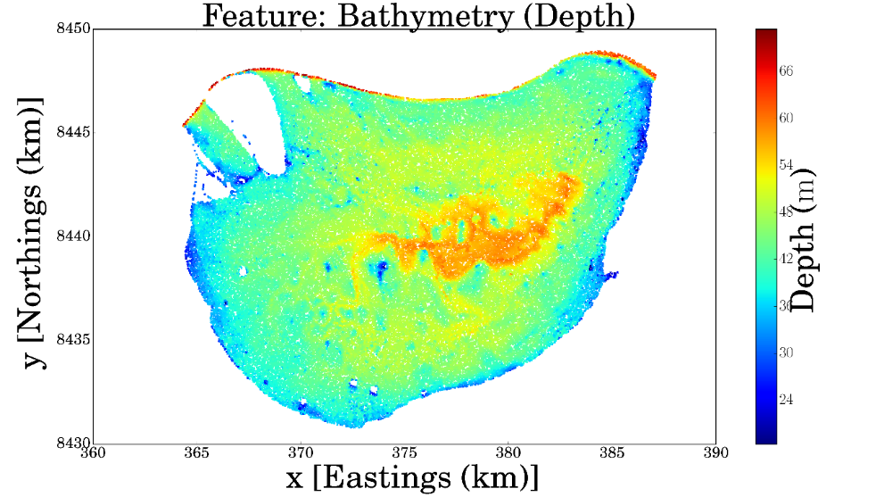
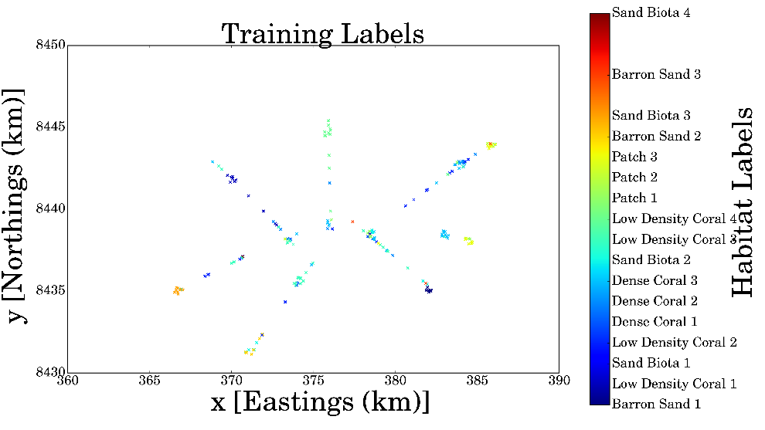
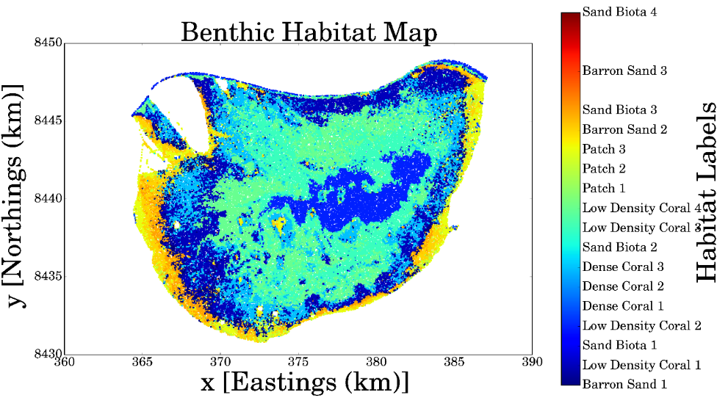
Benthic Habitat Mapping

Slide 11
Benthic Habitat Mapping

Slide 12
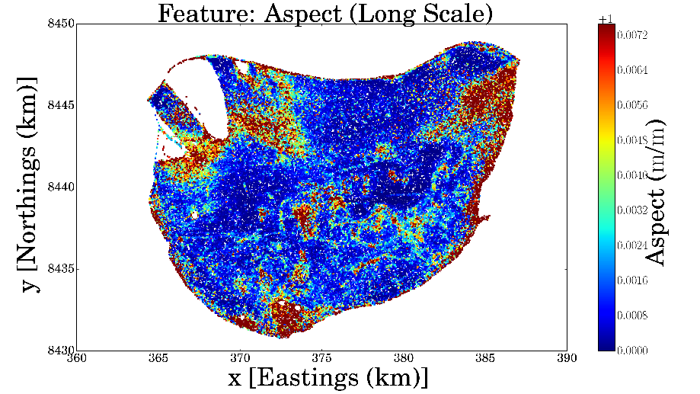
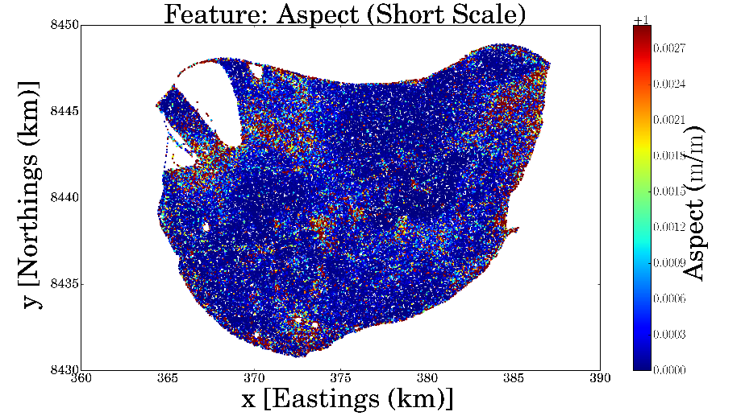
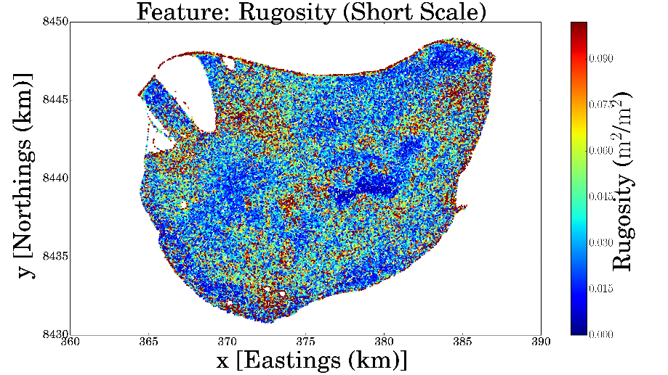
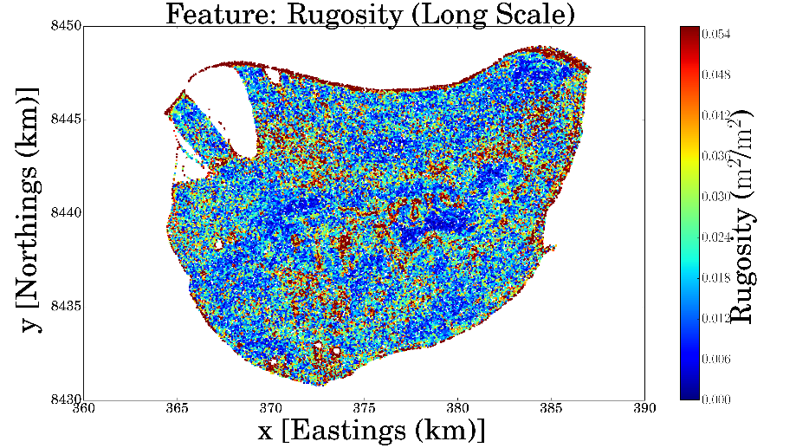
Benthic Habitat Mapping

Slide 13
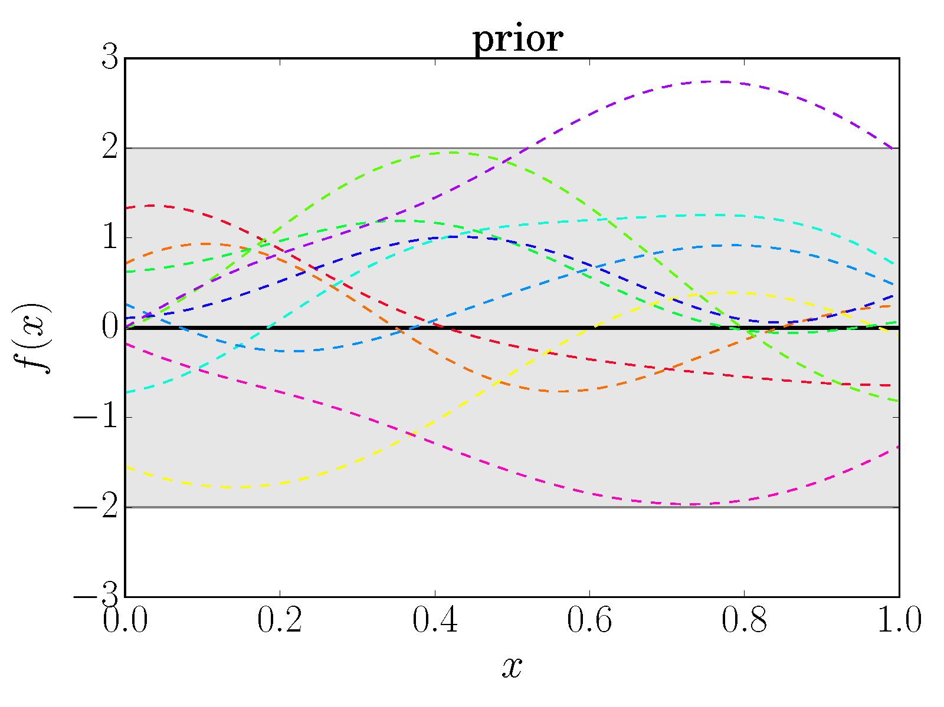
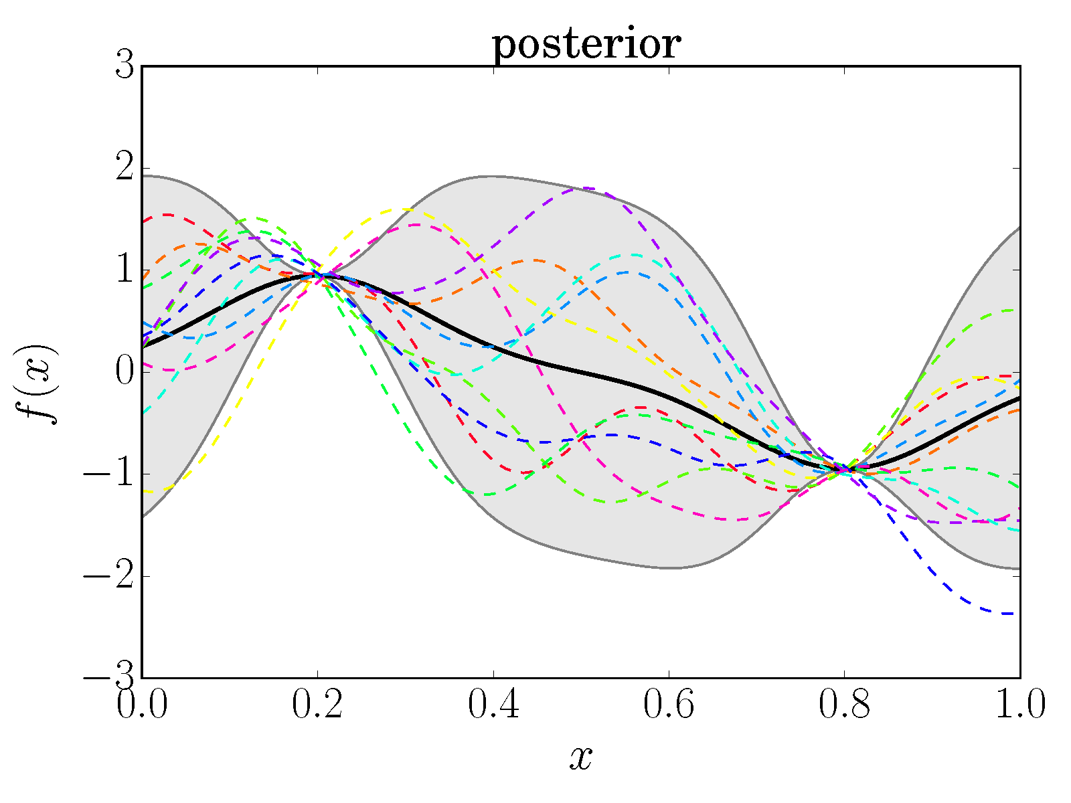
Gaussian Processes for Bayesian Modeling
Notes:
-Gaussian process: Non-Parametric and Bayesian Model
-Explain “Bayesian” and “Non-Parametric”
It is a Stochastic Process that generalises the usual multivariate Gaussian distribution. In fact, it can be seen as an infinite dimensional Gaussian distribution. As such, it can be used to model functions, instead of just finitely many variables.
-Define a GP
-Prior/Posterior

Slide 14


Gaussian Processes for Bayesian Modeling
Notes:
But wait!

Slide 15
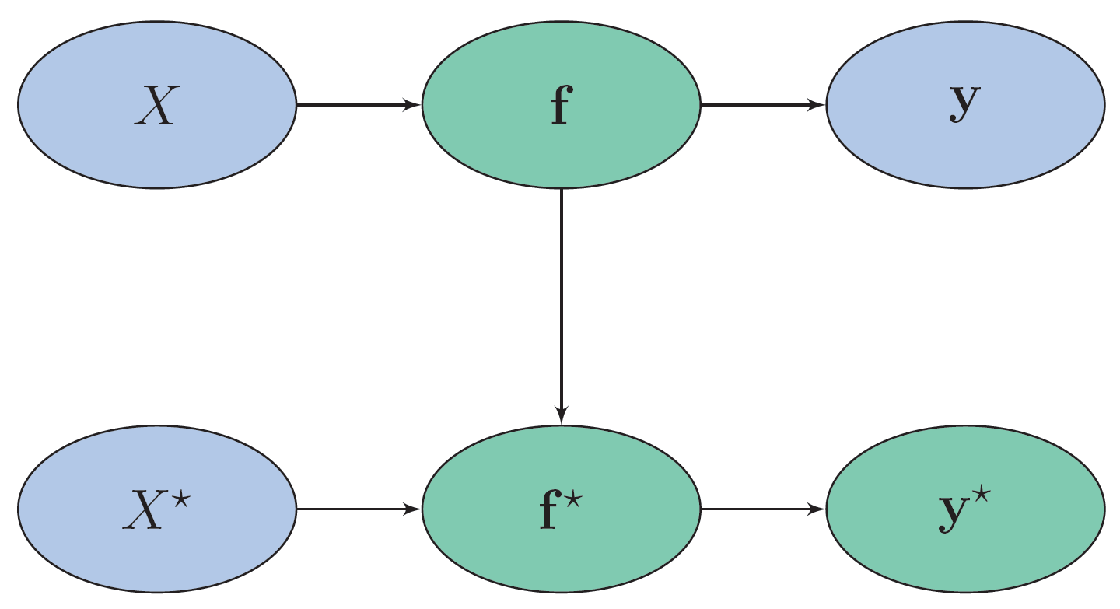
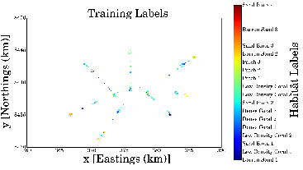
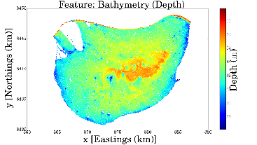
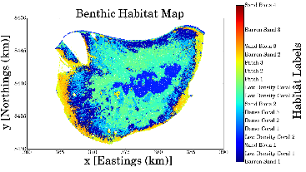
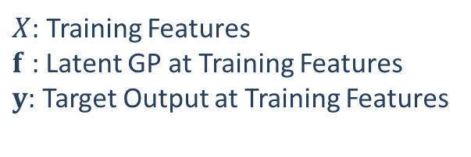
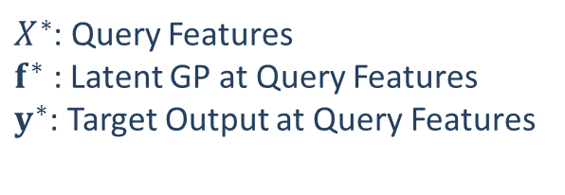
Gaussian Processes Classifiers
$X$: Training Features
$f$ : Latent GP at Training Features
$y$: Target Output at Training Features
Gaussian processes as an
intermediate latent function
$X^{∗}$: Query Features
$f^{∗}$ : Latent GP at Query Features
$y^{∗}$: Target Output at Query Features

Slide 16
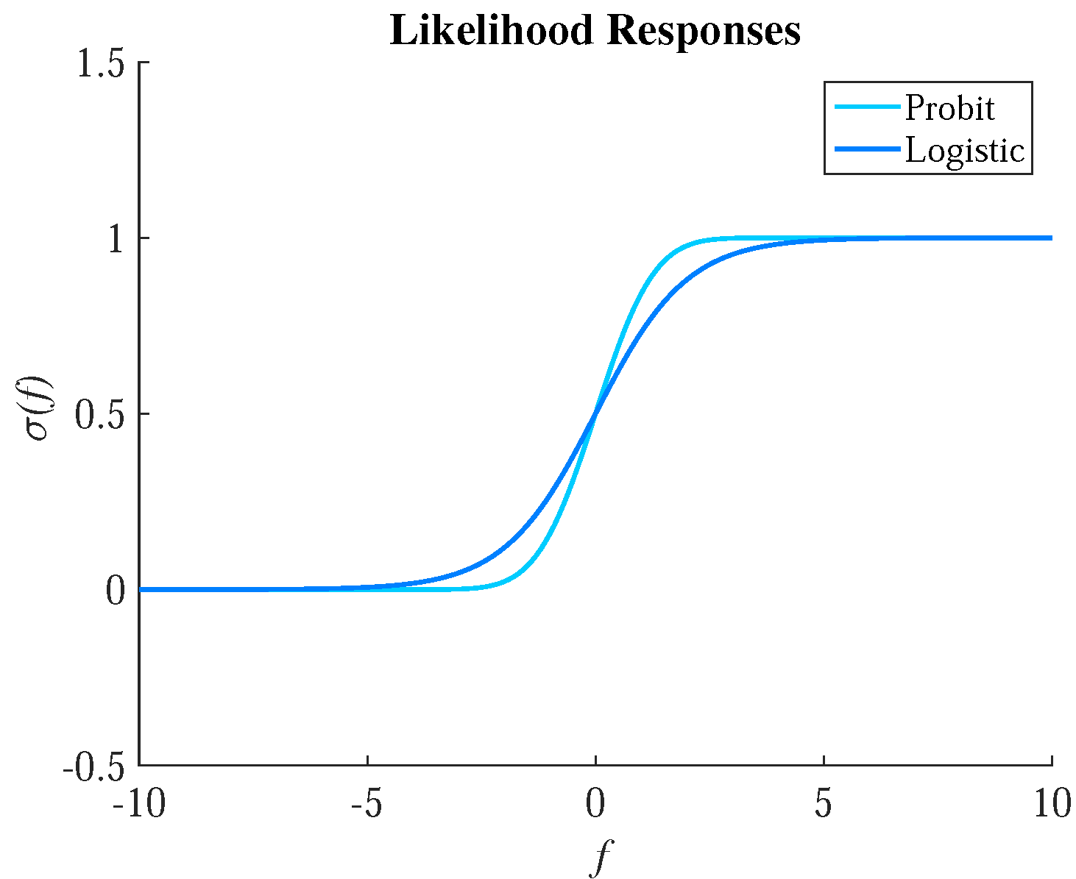
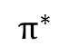

Gaussian Process Classifiers
$$f^{∗}$$
$$π^{∗}$$

Slide 17
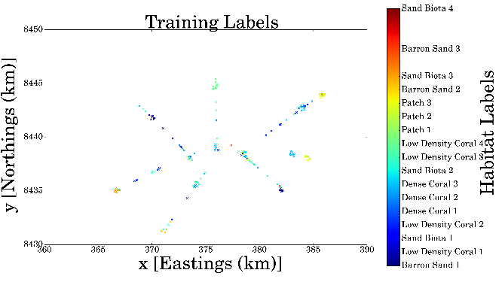
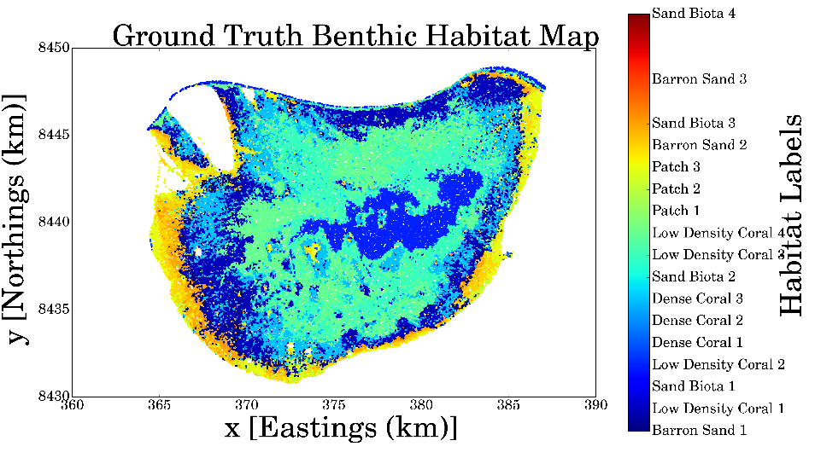
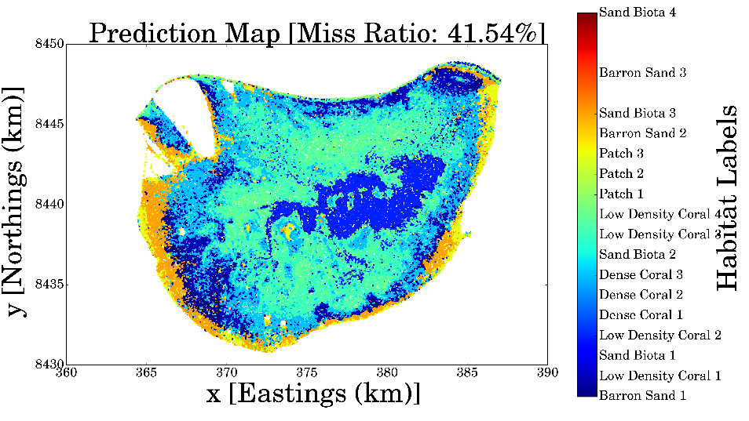
Mapping Benthic Habitats at Scott Reef
Ground Truth
Prediction of Benthic Habitats

Slide 18


Informative Seafloor Exploration: Acquisition Functions
Measures desirability of a candidate path
More Information -> More desirable
What is the best way to measure information?

Slide 19
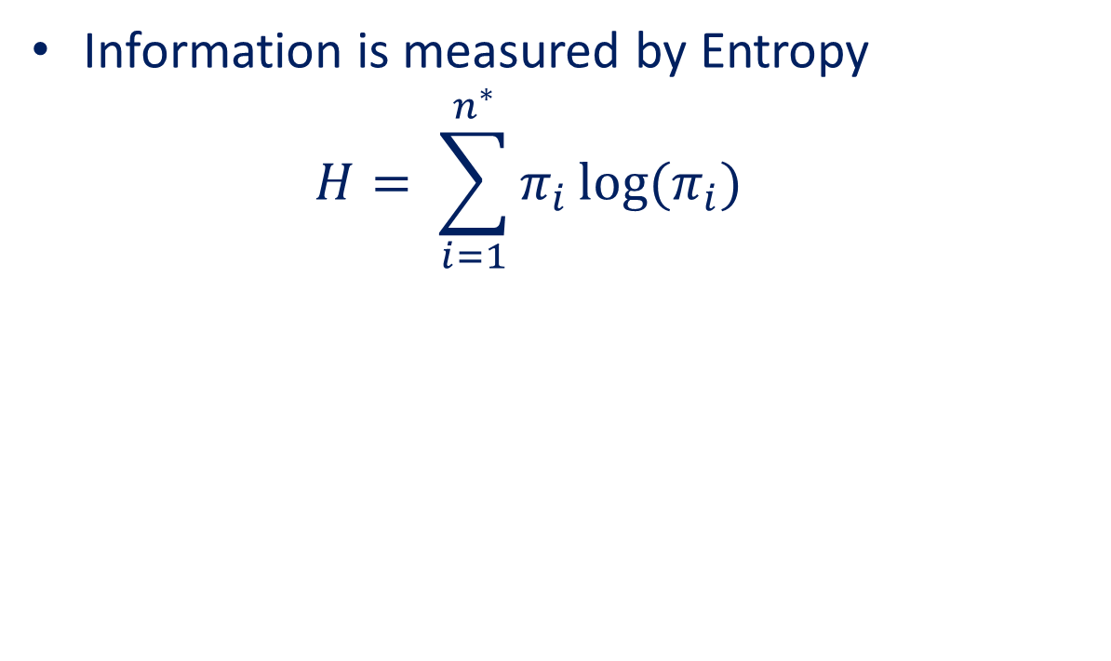
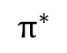

Informative Seafloor Exploration: Acquisition Functions
Information is measured by Entropy
$$H= \sum_{i=1}^{n^{∗}}{π_{i}}log⁡(π_{i})$$
$$f^{∗}$$
$$π^{∗}$$

Slide 20
Informative Seafloor Exploration: Acquisition Functions
Information is measured by Entropy
$$H= \sum_{i=1}^{n^{∗}}{π_{i}}log⁡(π_{i})$$
Has
Joint
Distribution
No Analytical
Joint Distribution
$$f^{∗}$$
$$π^{∗}$$
Monte Carlo?

Slide 21
Linearised Model Differential Entropy
Is the entropy of the prediction probabilities itself
Computationally faster and analytically tractable
Measures the ability to separate the classes
Able to handle uncertainty due to bias as well as variance
Has
Joint
Distribution
No Analytical
Joint Distribution
$$f^{∗}$$
$$π^{∗}$$

Slide 22
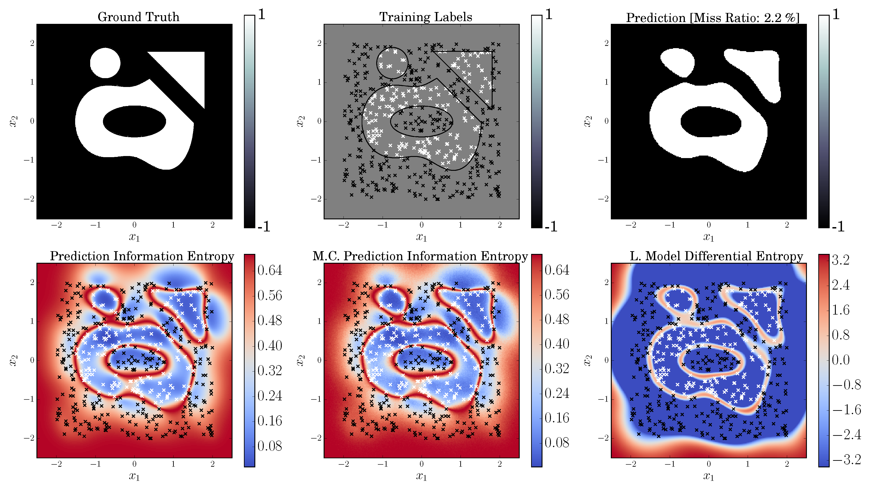
Prediction Information Entropy V.S. Linearised Model Differential Entropy

Slide 23
Receding Horizon Formulation

Slide 24
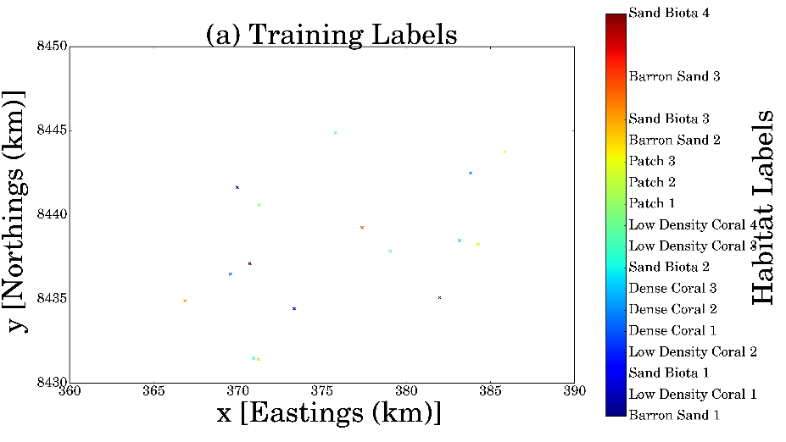
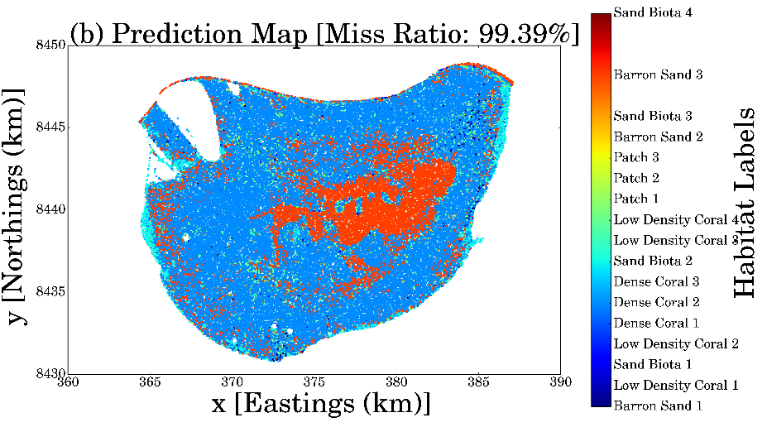
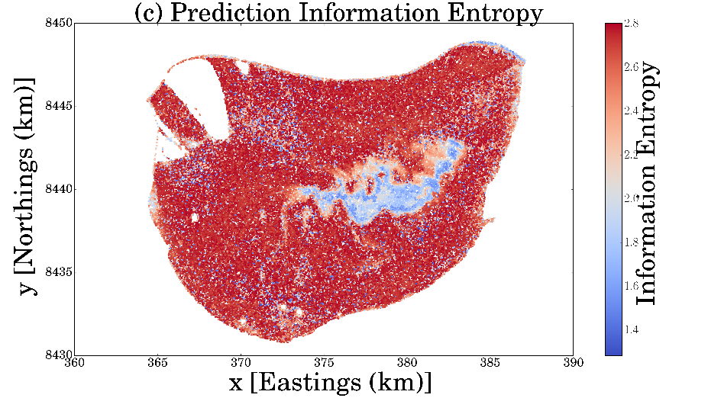
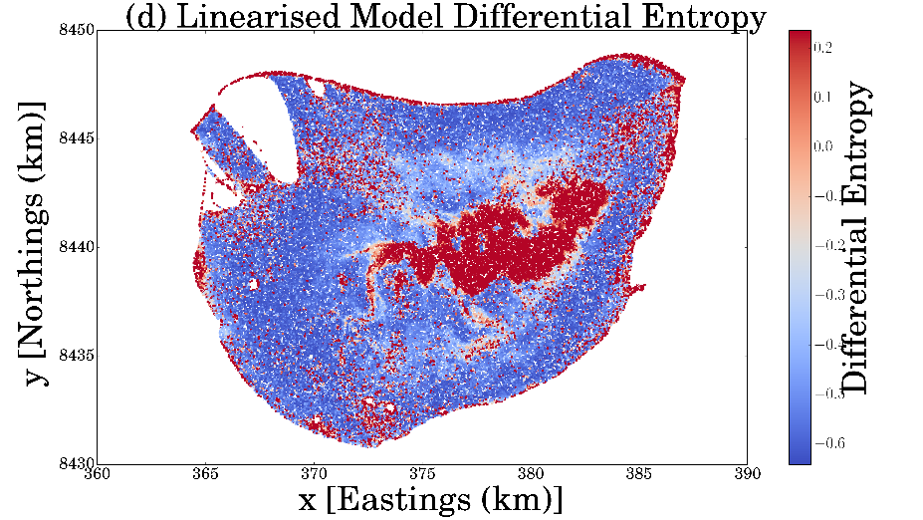
Initial Situation at Scott Reef

Slide 25
Informative Seafloor Exploration at Scott Reef

Slide 26
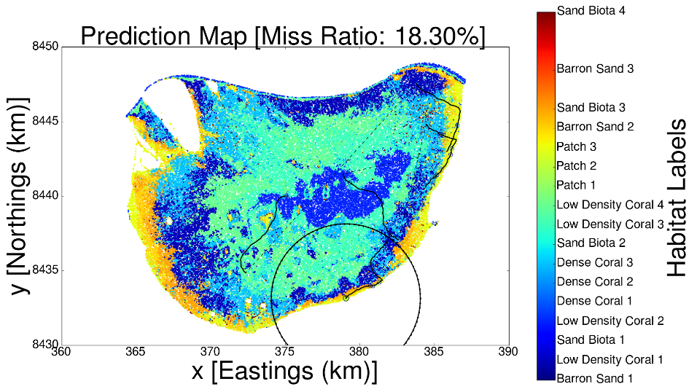
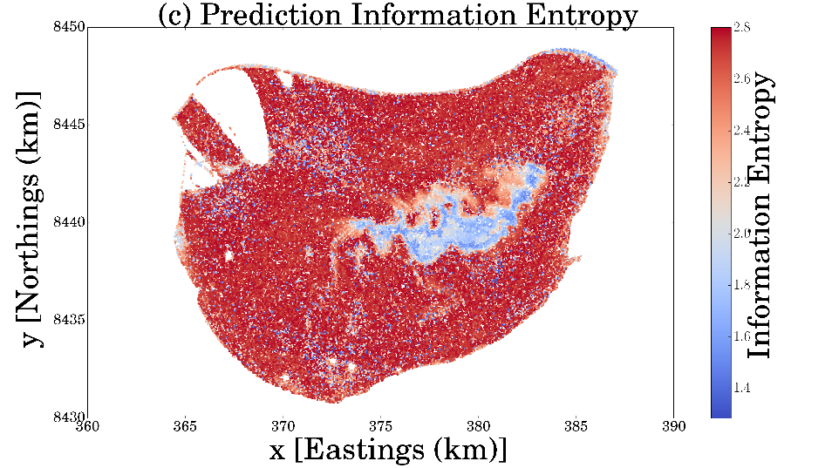
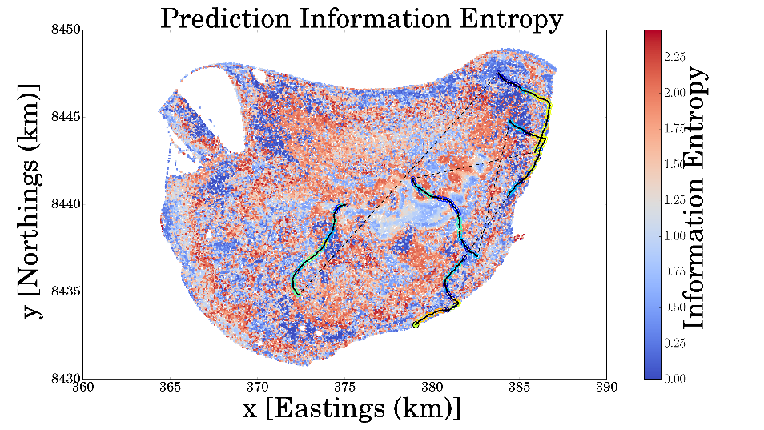
Informative Seafloor Exploration at Scott Reef

Slide 27
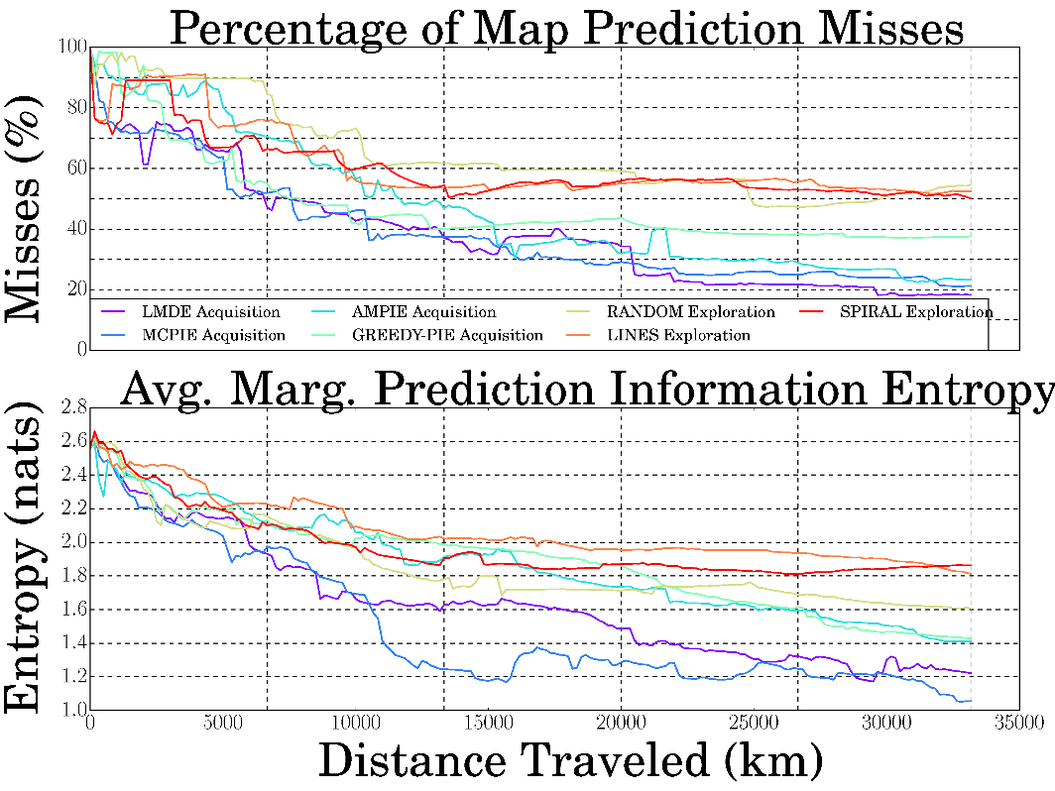
Informative Seafloor Exploration at Scott Reef
Final Mapping Error (%)
Policy | LMDE | MCPIE | AMPIE | GREEDY | RAND | LINES | SPIRAL
Test 1 | 18.30 | 21.22 | 23.21 | 37.54 | 54.63 | 52.54 | 50.06
Test 2 | 16.44 | 22.99 | 32.11 | 43.86 | 34.87 | 20.40 | 33.74
Test 3 | 20.38 | 27.01 | 40.11 | 37.63 | 35.68 | 25.05 | 43.16

Slide 29
Slide Title
Product A
Product B
Feature 1
Feature 2
Feature 3
Feature 1
Feature 2
Feature 3

